Slide 1
1.4 “Why and How Good Writing Counts”
Unit 1: Introduction & Organization

Slide 2
The Deadline Dilemma
You're fighting a deadline… why add yourself to your list of problems???
Having good writing skills that you know like the back of your hand can help!!!
Know the basics!
Spend time in the right places
Practice makes better… not perfect!
Now let the story come to you!
Trust your gut!!!
Where to Begin?
Crafting a perfect “LEDE”
Intro sentence used to grab reader
Taking time to do this will actually save you time…
HOW?
Help you organize the rest of the story
Formula?
Craft a lede that feels good!
Use your heart and gut more than your head in this case
How?
Start a dialogue w/ your audience
Let that conversation organize the rest of the story!

Slide 3
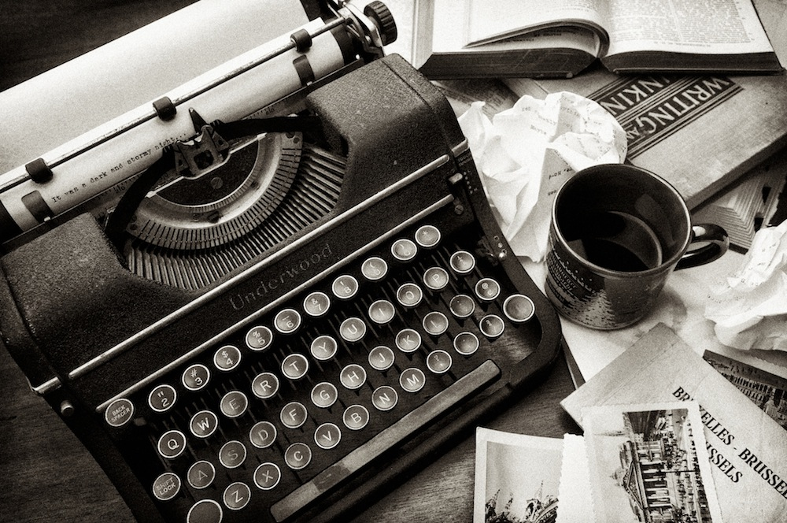
Getting the Subject from One Mind to Another
Role of the Journalist?
Present unbiased facts, descriptions, ideas, quotes to the audience so they can make decisions
Needs to reach audience exactly as it would have before you got your hands on it!
You are a reporter--not a recorder!
You decide what to include and what not to
Based on newsworthiness and sway

Slide 4
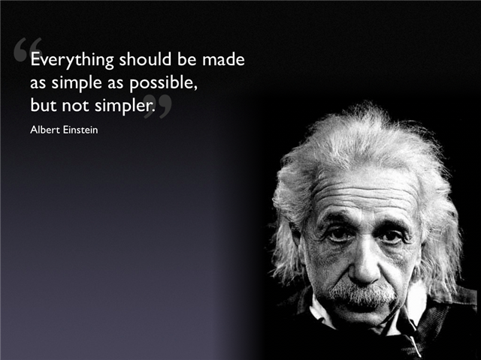
KISS: Keep It Simple, Stupid!
Keep it simple w/o insulting the reader’s intelligence
Simple not Simplistic!
Simple- w/o embellishment
Simplistic- tendency to oversimplify; ignoring the complexities
“the best journalistic writing can address a complicated subject and convey it to the reader in easily digested components.”

Slide 5
The Jargon Trap
Jargon- terminology specific to a particular audience
Limits the audience who can truly benefit from your writing
Not all bad though…
Provides special meaning to appropriate audience
Know who you are trying to reach with your article!

Slide 6
Jargon!
Becomes a problem when used for a general audience
Makes article seem unclear and confusing at best, and pompous at worst!
Overall, be aware of it and avoid using it in professional/formal writing!
Angers audience!
“You think I’m impressed?”
“I’m too lazy to find language to reach audience…”
“I don’t know what I’m writing about, but I can fool you to think I do!”
“I’m trying to trick or conn you!”

Slide 7
The Blessings of a Well-Crafted “LEDE ”
Purpose- sets up the story; getting the audience’s attention!
tells reader what the story will cover
summarizes the story
entices the reader to continue to read

Slide 8
The “LEDE”
What to Include…
Lead with what is newsworthy
Lead with what is dramatic and / or captivating
Inform the reader
Tease, anger, challenge, intrigue, or prepare reader with what is next
Readers are picky; if you bore them, they will retaliate and refuse to read the rest of what you’ve written!
This is the part you have to take your time… it pays off in the end!!!
The 5 Ws:
WHO
WHAT
WHERE
WHEN
WHY
HOW
+
Hook
LEDE
=

Slide 9
The Style Trap
Some writers look for a “Style”
Spend all their time looking, or…
Trying to force it
Crafting a style that is theirs
Don’t worry about this!!!
Good journalists concentrate on writing simply, honestly, and directly to the reader.
Your “Style” will develop on its own, organically.

Slide 10
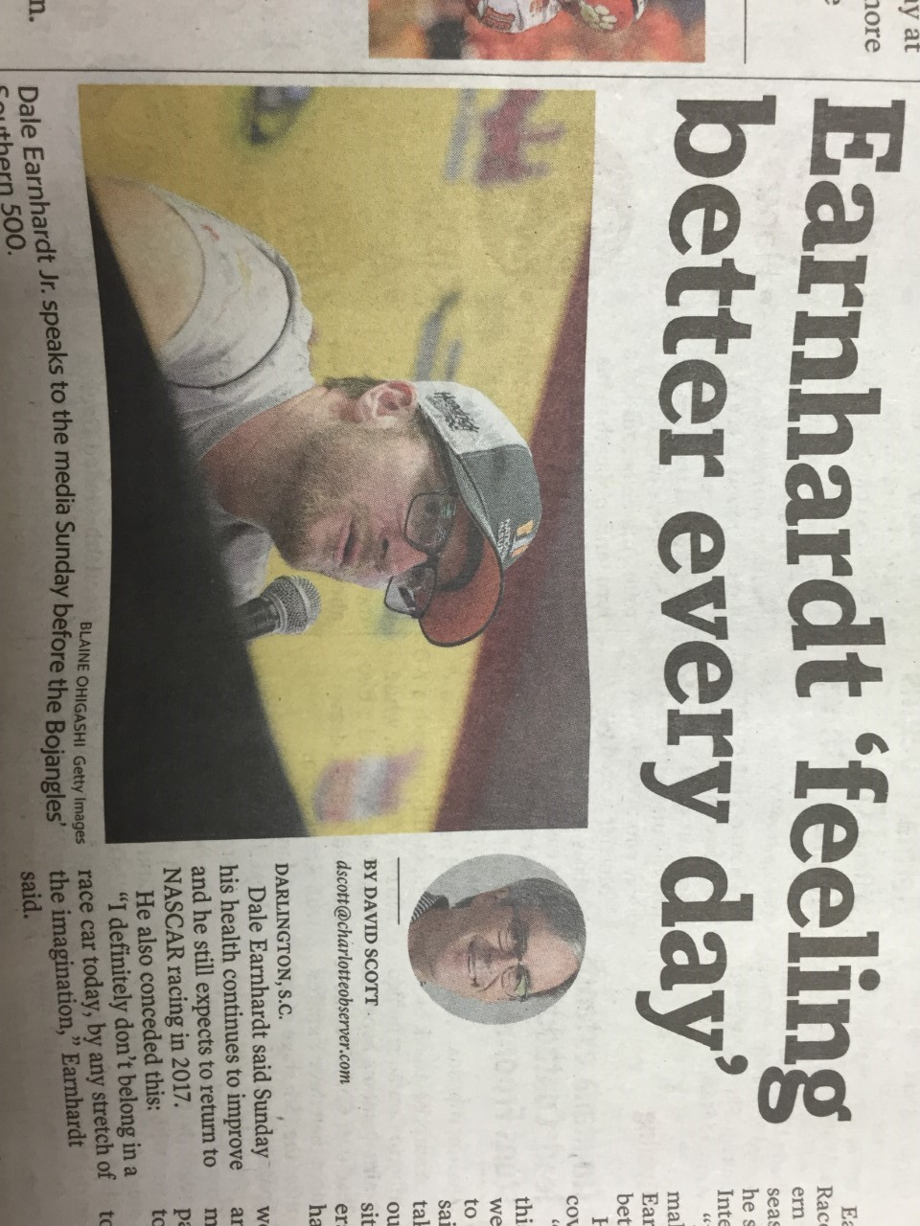
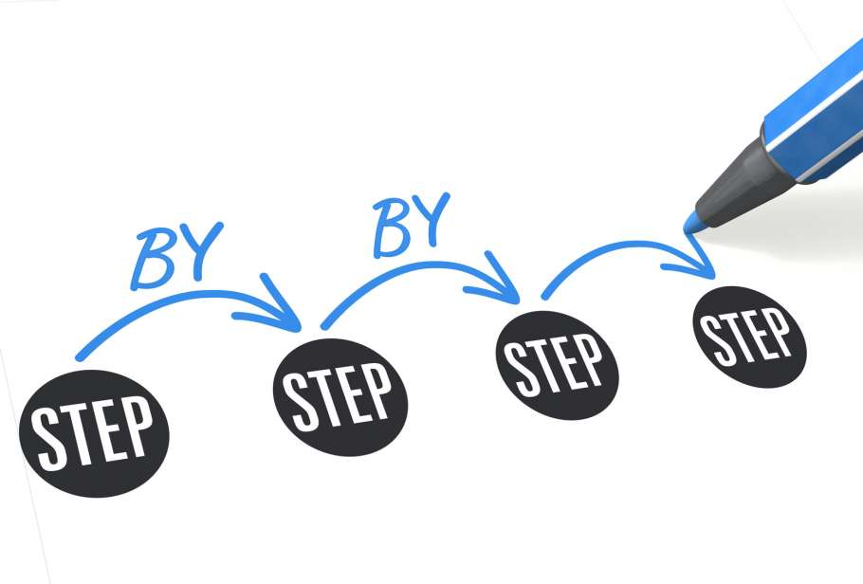
the “Time-Saving, On-Deadline Formula”
Time- ½ crafting lede, ½ researching, interviewing, writing, completing
Lede saves time by setting up rest of article
How?
Sets up a dialogue b/t author and audience
Steps
Lede
Insert quote from interview
One that engages and grabs reader
Then ask what would the reader want to know next
Then answer that question
Rinse and repeat step 3!
Steps???

Slide 11
Basic Guidelines for Developing Writing Skills
General Tips
Make every word count!
If a word doesn’t carry its own weight, get rid of it
When all else fails, write with energy!
Convince the reader you are convinced!
3 Main Ingredients to Good Writing
Force yourself to fall in love with your subject
Write for the ear! Journalism should be written conversationally
Help you find rhythm and flow
Fall in love with the language
Know who your audience is and write directly to them
Be unbiased!!!
Use strong nouns and verbs
Cut down (limit) your use of modifiers
Adjectives and Adverbs
Avoid clichés
Be specific!
Use color when you can, but do so w/ details
Color provides reader “feeling of true to life” or reality
Provides depth and background
Don’t just say the dress is pretty!
Describe it!!!

Slide 12
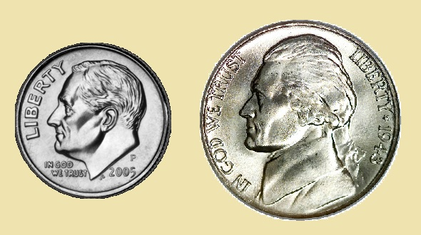
Bigger Does Not Always Mean Better
Article Length
English language contains more than 600,000 words
3-4x more than any other Western Language
Shakespeare only used 34,000 different words ever!!!
King James Bible- 8,000 different words
Gettysburg Address- 266 total
10 Commandments- 173 total
KISS
Don’t try to create a false sense of importance… bigger is not always better!

Slide 13
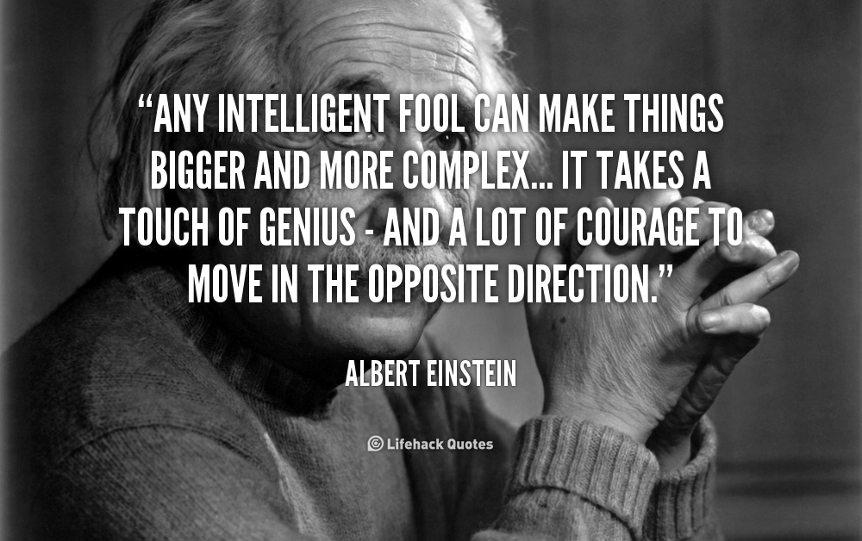
Bigger Does Not Always Mean Better
Bigger words are not always better
Get your point across with simpler text—less is more!
Sometimes…
“Adjacent” or “Next To”?
Work towards word precision--not toward a human thesaurus!

Slide 14
Ethics in Journalism
Journalism is supposed to be… a profession which prides itself on truth and accuracy. In this new age of instant media, journalists’ audiences have to believe in their truth and accuracy for the journalist to survive. A lack of sound, ethical decisions equals a lack of credibility in the eyes of the public.

Slide 15
3 Keys to Teaching Journalistic Ethics
Students must question their actions, their motives, and the expected outcome.
Students must discuss with others, challenge their views and beliefs and come to an editorial decision.
Students must be given time to reflect and process their personal beliefs and viewpoints.

Slide 16
Questions to ask yourself before publishing
What do I know? What do I need to know?
What is my journalistic purpose?
What are my ethical concerns?
What rules (organizational policies and professional guidelines) should I consider?
How can I include other people with different perspectives and diverse ideas?

Slide 17
Who are the stakeholders – those affected by my decision? What are their motivations? Which are legitimate?
What if the roles were reversed? How would I feel if I were in the shoes of one of the stakeholders?
What are the possible consequences of my actions? Short term? Long term?

