Slide 1
Unit 6: Crafting Excellence
6-3
Peer-Editing an Article

Slide 2
Peer-Editing?!?
Define-
students work with someone their own age-usually someone in the same class-to help improve, revise, and edit a piece of student writing
Brainstorm
Pros?
Cons?

Slide 3
3 Steps
Steps to follow when peer-editing someone’s work:
Step 1- Compliments
Step 2- Suggestions
Step 3- Corrections

Slide 4
Step 1- Compliments
The first rule of Peer Editing is to STAY POSITIVE!
Remember, you’re helping to change someone else’s work.
Think about how you would feel if someone were telling you what needed to be improved in your own writing…

Slide 5
Step 1- Compliments
Always start with COMPLIMENTS!
Tell the writer what you think he or she did WELL
Examples…
I really loved your topic
I think you used a lot of good details
I liked when you did this
My favorite part was ___ because…
This was a really good read because…
I like the way you…

Slide 6
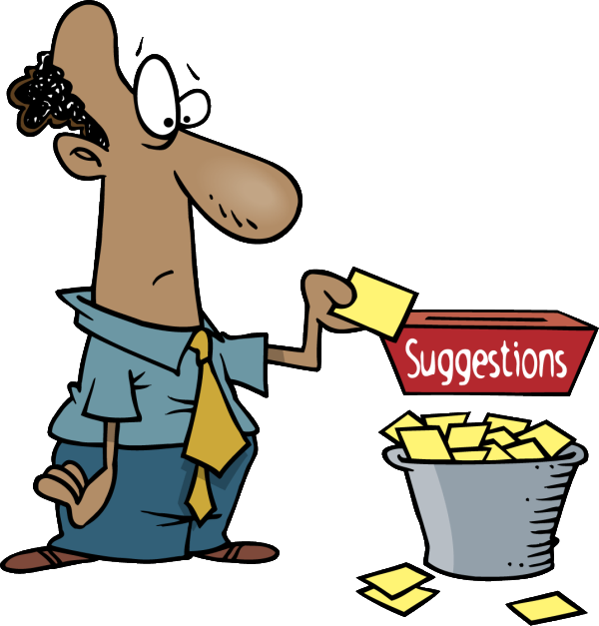
Step 2- Suggestions
Making suggestions means giving the author some specific ideas about how to make his or her writing better.
Remember- stay positive and be specific!
Instead of, “It didn’t make sense,” say, “If you add more details after this sentence, it would be more clear.”
Instead of, “Your word choice was boring,” say, “Instead of using the word ___, maybe you can say ___.”

Slide 7
Step 2- Suggestions
Here are some areas that you may want to make suggestions about:
Word Choice
Using Details
Organization
Sentences
Topic
Concept / Content
Flow
etc.

Slide 8
Step 3- Corrections
The 3rd step in the peer editing process is making corrections.
Corrections means checking your peer’s paper for
Spelling Mistakes
Grammar Mistakes
Missing Punctuation
Incomplete or Run-On Sentences
Paragraphs
Homophones

