Slide 1
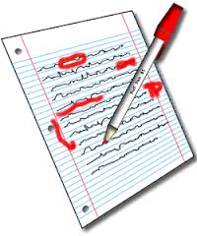
Unit 6: Crafting Excellence
6-1: Editing for Content—copy down what is underlined

Slide 2
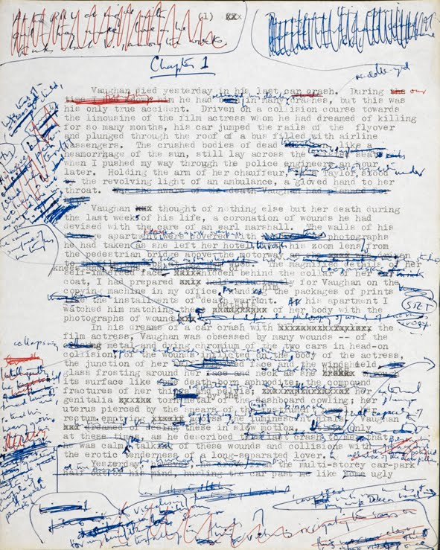
FYI
Editing is messy
Editing is meant to make what you created even BETTER
Everyone has to edit their writing
There are 2 ways to edit any piece of writing:
For content
For grammar
But before you start editing, you must write!
WRITE FIRST, EDIT AFTER—get your ideas out first, then you actually have something to edit.

Slide 3
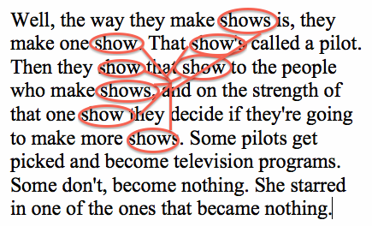
Editing for Content
Also known as revising
Editing for content means:
you’re making sure things are accurate
your writing flows and makes sense
and your ideas are conveyed well and effectively.
This also means that your ideas aren’t taking forever to explain—you’re being efficient with your writing (not too wordy).

Slide 4
Editing for Grammar means…
Your spelling is correct
Your commas are correct
You have semicolons and you know how to use them
Your sentences actually have punctuation to end them.
Your sentences begin with CAPITAL letters
Proper nouns are capitalized (such as people’s NAMES… like your own name)

Slide 5
How to Edit for Content (Write these steps down…)

Slide 6
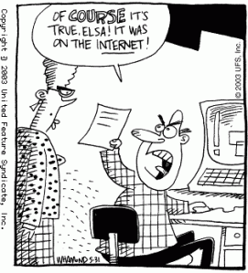
1. Check Your Facts, Confirm Your Sources
Journalists must maintain their credibility!
Their sources’ correctness or incorrectness WILL affect them in a good or bad way!
Make sure you’re spelling your sources’ names correctly (even if their name is John Smith! It could be Jon Smith, John Smithe, John Smith, who knows!)
Did you get your information from a reliable source?
If quoting, is it accurate (according to your source)?

Slide 7
2. Eliminate clichés, clunky prose, and slang
What’s a cliché?
Cliché: An overused expression or phrase that has lost its originality and impact
Why avoid it in your writing?
Who wants to read things they hear/see all the time??
Clunky Prose = wordiness for the sake of being wordy to have more words in your wordy, written article.
Slang
Nothing in your article is lit, tight, sweet (unless you’re talking about sugary things), or any other word with an expiration date

Slide 8
3. Cut the Fat
Be EFFICIENT with your writing—use only the words you need to effectively express your idea and NO MORE than that!
One student volunteer will read the following out loud:
Inefficient:
As I was pulling into my driveway, I realized that we were going to be having a birthday party soon, so I decided to go back out and pick up some of the supplies that we might have needed. (word count = 39)
A different student will read this one out loud:
Efficient:
As I pulled into the driveway, I realized that we’re having a birthday party next weekend, so I turned around to go buy party supplies. (word count = 25)
Same idea, but the second one is WAY more efficient!

Slide 9
4. Listen for your own mistakes— Read it out loud, but not to someone else
Your writing should make sense to someone else on its own—if you read your writing to someone, you will make it sound the way you want to.
When you read it out loud to yourself, you’re more likely to catch mistakes in the way you structured sentences.
You know how it should sound, so sometimes it’s easier to hear our mistakes than to see them on paper.

Slide 10
Read the following quietly to yourself:
“I didn’t think being a student could be so cool,” said one of Hillary Bernard’s students while abroad the London Eye—the second tallest ferris wheel in the world. In July of 2016, Bernard traveled to Dublin, Ireland and London, England with forty-seven other students and adults for 9 days.
The students had a lot of fun. Traveling on the airplane lasted several hours, and everyone was instructed to sleep on the long plane ride over. For thirty-seven 8th and 9th graders, it was the adventure of a lifetime to travel internationally with so many of their peers. With 2 days being reserved for travel, the group spend 3 days in Dublin, 1 in Wales, and 3 in London.”

Slide 11
What’s wrong? Think content—not grammar
This is redundant—the author shows us this when it states” “For thirty-seven 8th and 9th graders, it was the adventure of a lifetime to travel internationally with so many of their peers.”
“I didn’t think being a student could be so cool,” said one of Hillary Bernard’s students while abroad the London Eye—the second tallest ferris wheel in the world. In July of 2016, Bernard traveled to Dublin, Ireland and London, England with forty-seven other students and adults for 9 days.
The students had a lot of fun. Traveling on the airplane lasted several hours, and everyone was instructed to sleep on the long plane ride over. For thirty-seven 8th and 9th graders, it was the adventure of a lifetime to travel internationally with so many of their peers. With 2 days being reserved for travel, the group spend 3 days in Dublin, 1 in Wales, and 3 in London.”

Slide 12
What else?
This is random—but that doesn’t mean it’s useless. Take it out of this paragraph and save it for later—it might be useful in a different paragraph.
“I didn’t think being a student could be so cool,” said one of Hillary Bernard’s students while abroad the London Eye—the second tallest ferris wheel in the world. In July of 2016, Bernard traveled to Dublin, Ireland and London, England with forty-seven other students and adults for 9 days.
Traveling on the airplane lasted several hours, and everyone was instructed to sleep on the long plane ride over. For thirty-seven 8th and 9th graders, it was the adventure of a lifetime to travel internationally with so many of their peers. With 2 days being reserved for travel, the group spend 3 days in Dublin, 1 in Wales, and 3 in London.”

Slide 13
Anything else?—this is a work in progress!
“I didn’t think being a student could be so cool,” said one of Hillary Bernard’s students while abroad the London Eye—the second tallest Ferris wheel in the world. In July of 2016, Bernard traveled to Dublin, Ireland and London, England with forty-seven other students and adults for 9 days.
For thirty-seven 8th and 9th graders, it was the adventure of a lifetime to travel internationally with so many of their peers. With 2 days being reserved for travel, the group spend 3 days in Dublin, 1 in Wales, and 3 in London.”
Traveling on the airplane lasted several hours, and everyone was instructed to sleep on the long plane ride over.

Slide 14
A different one—read quietly to yourself
A world record-breaking 112 pound king salmon was caught yesterday afternoon in the Kenai River near Soldotna, Alaska. The fisherman, a 13 year-old from Seattle, Washington, was fishing with his father.
Cameron Blake was fishing with his father on an annual trip to Alaska when his reel was tugged very hard by something in the river, assumedly a fish. Quickly realizing that this was no easy job, his father, Don Blake, stepped in. “I thought he was exaggerating,” his father stated. “Then, I reeled the fish in with everything I had!”
Mr. Blake and his son will filet and freeze the meat to be sent back to Seattle. “It was as big as a whale!” stated the excited Cameron Blake. His sister, Michelle, was not able to make the trip.

Slide 15
Repetitive
A world record-breaking 112 pound king salmon was caught yesterday afternoon in the Kenai River near Soldotna, Alaska. The fisherman, a 13 year-old from Seattle, Washington, was fishing with his father.
Cameron Blake was fishing with his father on an annual trip to Alaska when his reel was tugged very hard by something in the river, assumedly a fish. Quickly realizing that this was no easy job, his father, Don Blake, stepped in. “I thought he was exaggerating,” his father stated. “Then, I reeled the fish in with everything I had.”
Mr. Blake and his son will filet and freeze the meat to be sent back to Seattle. “It was as big as a whale!” stated the excited Cameron Blake. His sister, Michelle, was not able to make the trip.

Slide 16
Cut the fat—you don’t need to say this.
A world record-breaking 112 pound king salmon was caught yesterday afternoon in the Kenai River near Soldotna, Alaska. The fisherman, a 13 year-old from Seattle, Washington, was fishing with his father.
Cameron Blake and his father were on an annual trip to Alaska when his reel was tugged very hard by something in the river, assumedly a fish. Quickly realizing that this was no easy job, his father, Don Blake, stepped in. “I thought he was exaggerating,” his father stated. “Then, I reeled the fish in with everything I had.”
Mr. Blake and his son will filet and freeze the meat to be sent back to Seattle. “It was as big as a whale!” stated the excited Cameron Blake. His sister, Michelle, was not able to make the trip.

Slide 17
Cliché– use a different quote, if possible
A world record-breaking 112 pound king salmon was caught yesterday afternoon in the Kenai River near Soldotna, Alaska. The fisherman, a 13 year-old from Seattle, Washington, was fishing with his father.
Cameron Blake and his father were on an annual trip to Alaska when his reel was tugged very hard by something in the river, assumedly a fish. Quickly realizing that this was no easy job, his father, Don Blake, stepped in. “I thought he was exaggerating,” his father stated. “Then, I reeled the fish in with everything I had.”
Mr. Blake and his son will filet and freeze the meat to be sent back to Seattle. “It was as big as a whale!” stated the excited Cameron Blake. His sister, Michelle, was not able to make the trip.

Slide 18
Random—this doesn’t help the story!
A world record-breaking 112 pound king salmon was caught yesterday afternoon in the Kenai River near Soldotna, Alaska. The fisherman, a 13 year-old from Seattle, Washington, was fishing with his father.
Cameron Blake and his father were on an annual trip to Alaska when his reel was tugged very hard. Quickly realizing that this was no easy job, his father, Don Blake, stepped in. “I thought he was exaggerating,” his father stated. “Then, I reeled the fish in with everything I had!”
Mr. Blake and his son will filet and freeze the meat to be sent back to Seattle. “We have enough fish meat to eat every day for a month!” stated the excited Cameron Blake. His sister, Michelle, was not able to make the trip.

Slide 19
Better:
A world record-breaking 112 pound king salmon was caught yesterday afternoon in the Kenai River near Soldotna, Alaska. The fisherman, a 13 year-old from Seattle, Washington, was fishing with his father.
Cameron Blake and his father were on an annual trip to Alaska when his reel was tugged very hard. Quickly realizing that this was no easy job, his father, Don Blake, stepped in. “I thought he was exaggerating,” his father stated. “Then, I reeled the fish in with everything I had!”
Mr. Blake and his son will filet and freeze the meat to be sent back to Seattle. “We have enough fish meat to eat every day for a month!” stated the excited Cameron Blake.

Slide 20
Another one…. Read to yourself
Because she was frustrated by the mundane, boring, and empty look in her locker, a middle school student in Davidson, North Carolina has started a line of products intended to spruce up every middle and high school student’s tiny square of space this 1997-1998 school year.
Middle schooler Avery Jetton, age 13, and her parents, Bill Jetton and Janet Jetton, have started a business called Spruced Space, selling products for use within school lockers. Such products for school lockers include decorations, magnetic containers to hold a variety of supplies a student may want to have held, and even small mirrors with a light to see better.
“She brought home the idea one day and started literally making things in her room,” described Avery’s mother, Janet. “After seeing how interested people were in these products, Bill and I decided to help her form this into an actual business. Now, she’s on her way to funding her own college education! We’re very proud of her! It’s very exciting!”
Avery’s line of locker products is available at www.mrsbernardmadethisupsodonttry
tofindit.com and includes useful products for teen girls and boys. Avery is hoping to soon expand her business to focus on helpful products for car interiors.

Slide 21
1st paragraph:
Never start a sentence with “because”!
Redundant: why list so many words that mean the same thing?
Make this one word shorter by just saying “middle schooler” instead of “middle school student.”
Because she was frustrated by the mundane, boring, and empty look in her locker, a middle school student in Davidson, North Carolina has started a line of products intended to spruce up every middle and high school student’s tiny square of space this 1997-1998 school year.
Better:
Frustrated by the mundane look in her locker, a middle schooler in Davidson, North Carolina has started a line of products intended to spruce up every middle and high school student’s tiny square of space this 1997-1998 school year.

Slide 22
2nd paragraph:
Repetative: already stated in article
We already know their name, and their names are the same—why state it again and again if they’re the same?
Too much explanation—cut the fat!
Middle schooler Avery Jetton, age 13, and her parents, Bill Jetton and Janet Jetton, have started a business called Spruced Space, selling products for use within school lockers. Such products for school lockers include decorations, magnetic containers to hold a variety of supplies a student may want to have held, and even small mirrors with a light to see better.
Better:
Avery Jetton, age 13, and her parents, Bill and Janet, have started a business called Spruced Space, selling products for use within school lockers, including decorations, magnetic containers to hold supplies, and even small mirrors with a light.

Slide 23
3rd and 4th paragraphs:
We already know her name—we don’t need to repeat!
Janet might have said this, but that doesn’t mean you have to include it—quotes must add substance, meaning, and insight to an article!
Be efficient—shorten where you can!
“She brought home the idea one day and started literally making things in her room,” described Avery’s mother, Janet. “After seeing how interested people were in these products, Bill and I decided to help her form this into an actual business. Now, she’s on her way to funding her own college education! We’re very proud of her! It’s very exciting!”
Avery’s line of locker products is available at www.mrsbernardmadethisupsodonttry
tofindit.com and includes useful products for teen girls and boys. Avery is hoping to soon expand her business to focus on helpful products for car interiors.
Better:
“She brought home the idea one day and started literally making things in her room,” described Avery’s mother. “After seeing how interested people were in these products, Bill and I decided to help her form this into an actual business. Now, she’s on her way to funding her own college education.”
Avery’s line of locker products is available at www.mrsbernardmadethisupsodonttry
tofindit.com and includes products for teen girls and boys. Avery hopes to soon expand her business to focus on helpful products for car interiors.

Slide 24
Better:
Frustrated by the mundane look in her locker, a middle schooler in Davidson, North Carolina has started a line of products intended to spruce up every middle and high school student’s tiny square of space this 1997-1998 school year.
Avery Jetton, age 13, and her parents, Bill and Janet, have started a business called Spruced Space, selling products for use within school lockers, including decorations, magnetic containers to hold supplies, and even small mirrors with a light.
“She brought home the idea one day and started literally making things in her room,” described Avery’s mother. “After seeing how interested people were in these products, Bill and I decided to help her form this into an actual business. Now, she’s on her way to funding her own college education.”
Avery’s line of locker products is available at www.mrsbernardmadethisupsodonttry
tofindit.com and includes products for teen girls and boys. Avery hopes to soon expand her business to focus on helpful products for car interiors.

Slide 25
Editing for Content:
Remember to follow these 4 steps!
Check Your Facts, Confirm Your Sources
Eliminate clichés, clunky prose, and slang
Cut the Fat
Read it out loud, but not to someone else
Once you’re happy with the way the story is written, then you can begin editing for grammar…

