Slide 1
Unit 5: Building the Story
5-1 “Digging for Information”

Slide 2
Dig it!
Job of a Journalists?
What is it ?!?
Job of a journalist?
Provide unbiased info to people
Why?
Make decisions about or that can affect their lives!
Where do journalists get the info?
Make it up?
Lie?
Listen to the man living on the corner?
Nope… through research!
What is research?
To investigate systematically so as to establish facts and reach conclusions
Huh?
To purposely find out all info you can!
Methods?
Books, encyclopedias, journal articles, interview,
Google® it

Slide 3
Kids Today…
“Just Google® It!”
Became the catch-phrase of this generation!
The problem is…
Too lazy to think for themselves so …
They believe everything they read on the internet!
“It was on Google®, it has to be true.”
“I found it on Wikipedia©”
“It was the first thing that popped up when I searched, and I was too lazy to actually open the link and read the article, so I just wrote it down as fact from the Google® Results Page.”

Slide 4
Research = Learning
Research is another form of learning, and there’s always more to learn about any topic!
Google can be helpful, but it’s not the only way!
What can you do to learn more about something besides “Google” it?

Slide 5
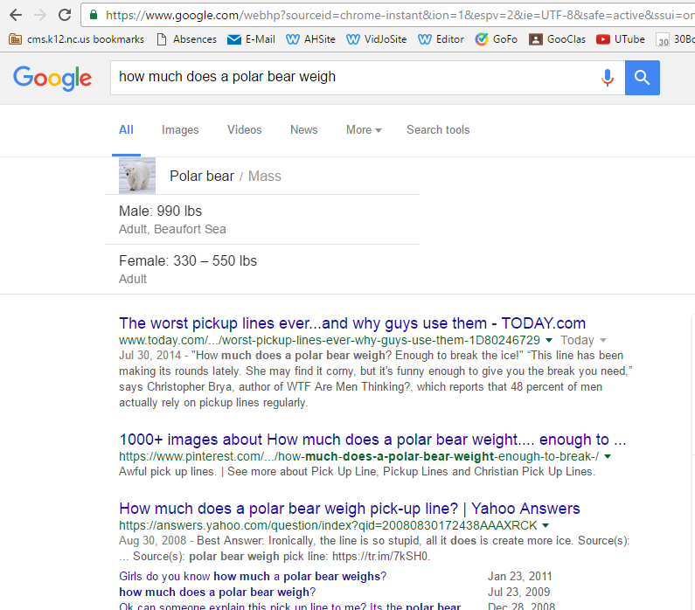
The Right Way to ‘Google®’ something…
How much does a polar bear weigh?
Google® It!
What do U type? Whole question?
Try It… What happens?

Slide 6
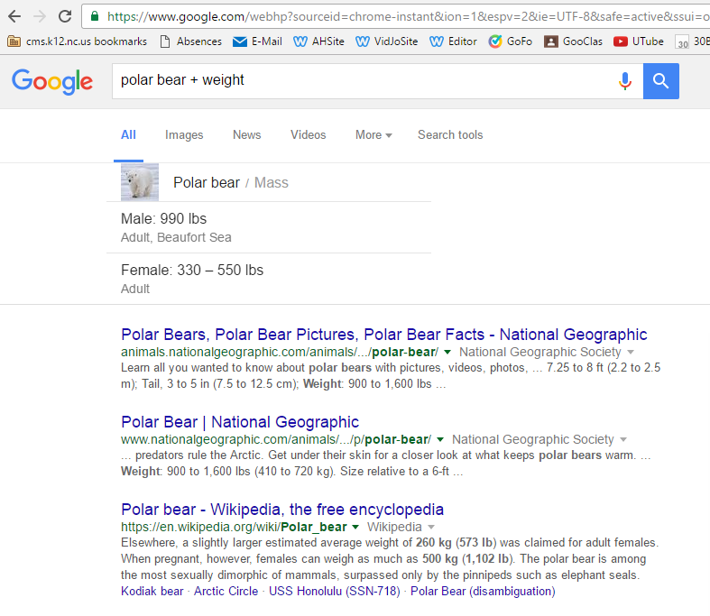
The Right Way to ‘Google®’ something…
How much does a polar bear weigh?
Google® It!
What do U type? Whole question?
Try It… What happens?
CPU will look 4 every word U typed anywhere in WWW!
Not very efficient!
Use “Search Terms”
Type in…
Polar Bear + Weight
# 4

Slide 7
The Right Way to ‘Google®’ something…
How much does a polar bear weigh?
Google® It!
What do U type? Whole question?
Try It… What happens?
CPU will look for every word you typed anywhere in WWW!
Not very efficient!
Use “Search Terms”
Type in…
Polar Bear + Weight
Can you see the difference?
Use Quotes
Gettysburg Address is the same as Gettysburg + Address to a CPU
Put in “” and Google will search for times those words are exactly as in “”
Notes:
Video on picture!!!

Slide 8
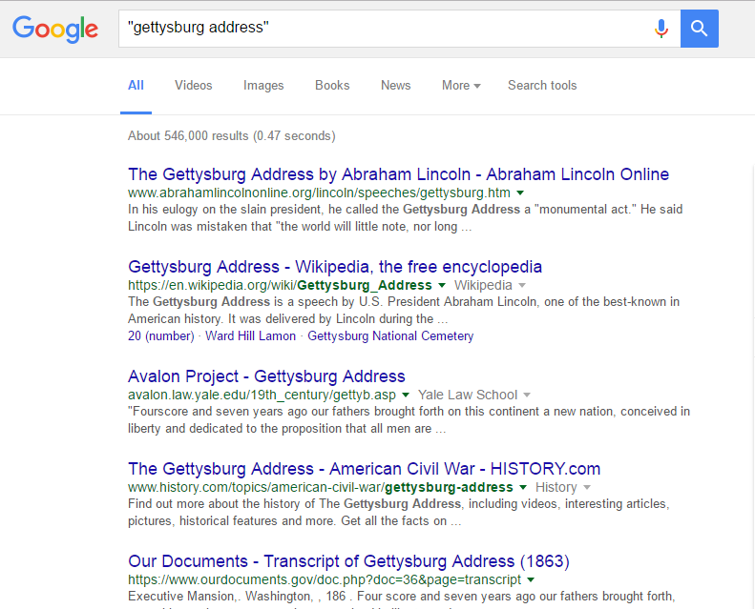
What’s It Look Like?!?
Parts
Title:
In blue, the first line of a search result
Web address:
In green, just under the title
This is the location of the page on the Web and can help you understand at a glance who is offering you the source, what kind of source it will be, etc.
Snippet:
The black text under the web address.
This text is taken from the source to which the link points and gives an idea of how your search terms appear in the text
NOT a summary of what appears on the link
Always click through to see the information they provide in context
Bolded Words:
The words that appear darker on the screen are your search terms.
In some cases, Google automatically finds synonyms for your search terms, so if you search for “kid,” you might see “child” bolded in your results

Slide 9
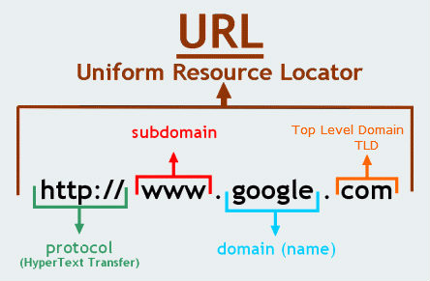
Domains / Extensions
Copy this down.
Feel free to color-code!
Domain
Website’s Name
Domain Extension
The Ending
Tells you what kind of website it is and
Lets you know if it can be trusted!

Slide 10
Domains Extensions
.COM
MOST-COMMON!
Originally used by For-Profit Businesses
Trying to make money; tell you what you want to hear
.ORG
Originally used by Not-For-Profit Businesses
Just want to get the info out there
.NET
Mostly used by Networks and Network Providers
Cheapest to buy!
.EDU
Used by sites of higher education
Universities and colleges
But…
Students there get these too!
.GOV
Limited to US, state, or local municipality/government sites
.BIZ
Attempt by businesses to take back .COM, but failed! Now used by anything!
Cheapest to buy!

Slide 11
Scale of Sketchiness … because not all websites are equal
.ORG
.EDU
.NET
Believable
… Not So Much
Believable
… Not So Much
.GOV
.COM
.BIZ

Slide 12
When in Doubt… Look at the Site!!!
Look for clues—if your site is legitimate, it’ll have a number of things:
Company that made it
not necessarily in the URL!
Copyright information
usually at the very bottom
Sources cited
Up-to-date information
Not ALL sites are current!
Some of them would collect dust if they could!!
Not taken care of Like a REAL site Would Be
When in doubt… Look for a name you know is good
Animals
National Geographic
Sports
ESPN

