Slide 1
Unit 4: Writing for the News
News Writing Basics
4-2 Crafting the Perfect LEDE

Slide 2
Recipe for the…
Perfect LEDE
1.) 1-2 Sentences
2.) Answers all of the “5 W’s”
3.) Includes a Dramatic HOOK to grab the
reader

Slide 3
Practice Review
Homework
Practice
Think / Pair / Share
Examine the Article
Read the professionally written LEDEs
Identify the “5 W’s”
Who
What
When
Where
Why
Identify the “H”
Hook
Notes:
For example, the lead is about 20-30 words, contains 5 W’s, a hook, etc. The middle contains the action, details of the story, quotes, etc. The end contains a quote, a finite ending, etc.

Slide 4
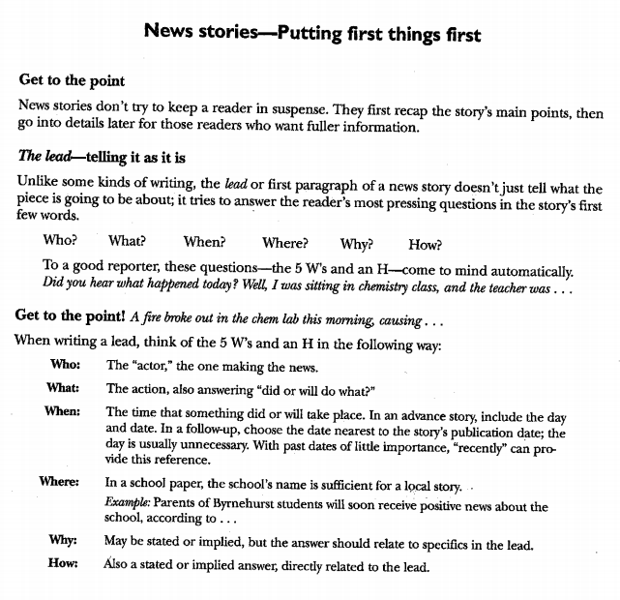

Slide 5
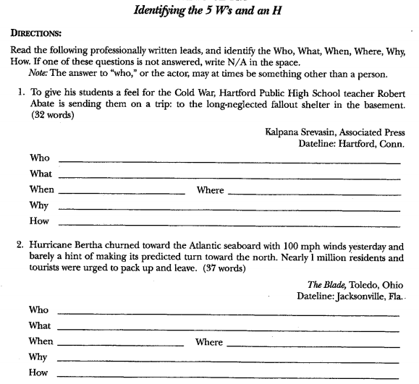

Slide 6
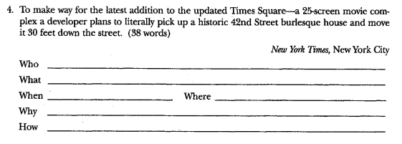

Slide 7
Activity Day
LEDE Stations
(the students you are sitting with are your group)
Each table will be station that will provide a CUT and the 5 W’s depicted in the graphic
As a group you will “CRAFT” a LEDE that follows “the recipe”
1-2 sentences MAX
30-45 words MAX
answers the 5 W’s
includes a dramatic HOOK 2 grab reader
Type into GoFormative.com next to the corresponding CUT
Notes:
For example, the lead is about 20-30 words, contains 5 W’s, a hook, etc. The middle contains the action, details of the story, quotes, etc. The end contains a quote, a finite ending, etc.

Slide 8
On a separate sheet of paper…
List this:
Who:
What:
Where:
When:
Why:
How:
Here’s your story:
Report what you had for dinner last night. Be precise!
Remember, don’t let your bias interfere with the facts! Even if you think the story is silly, it’s your job as the reporter to not let that show!

Slide 9
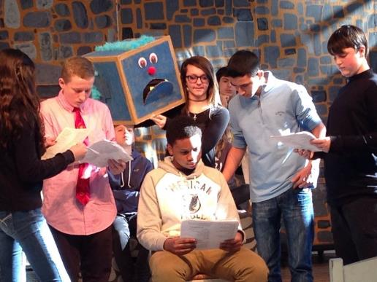
LEDE Station #1
Create
LEDE
Who: 8th Grade drama students
What: Practicing their lines
When: 2nd Block Honors Drama
Where: Room D-7; drama room
Why: For the upcoming drama production

Slide 10
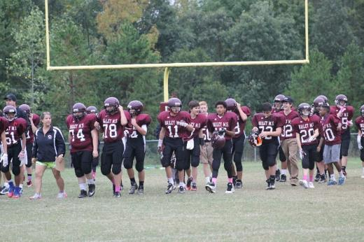
LEDE Station #2
Create
LEDE
Who: Bailey Football Team
What: Warming-up before a game.
When: Thursday, September 29th
Where: Bailey Road football field
Why: So the team is ready for the big game

Slide 11
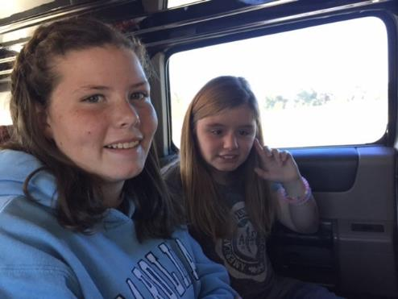
LEDE Station #3
Create
LEDE
Who: 2 Bailey Students
What: Limo Ride to mini-golf
When: Thursday, October 17th
Where: Driving to LKN Mini-Golf
Why: Both students sold more than 10 discount cards for the Fall Fundraiser.

Slide 12
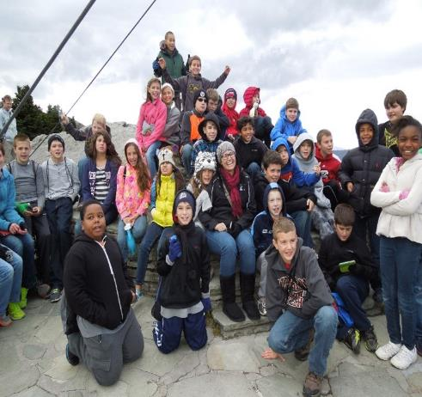
LEDE Station #4
Create
LEDE
Who: Ms. Singletary’s class
What: Climbing Grandfather Mountain.
When: Spring 2014
Where: Bridge at Grandfather Mountain
Why: try to get ids excited for 6th Grade Field Trip

Slide 13
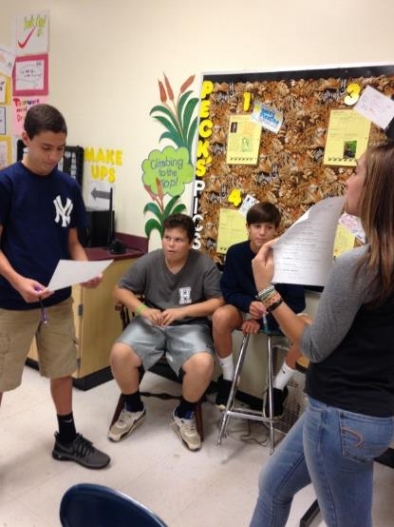
LEDE Station #5
Create
LEDE
Who: 8th Grade Spanish students from Mr. Applegarth’s A-Day
What: Practicing speeches
When: Fall 2016
Where: Room A-10
Why: To make sure they do well in front of the whole class.

Slide 14
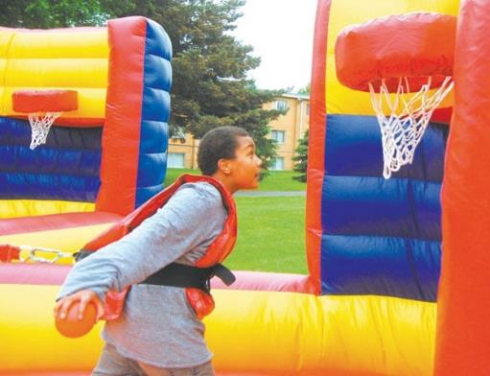
LEDE Station #6
Create
LEDE
Who: Bailey students and families
What: Bailey Back-to-School Celebration
When: Sept. 23rd
Where: Bailey Middle Football Field
Why: celebrate the beginning of the new school year

Slide 15
LEDE Station #7
Create
LEDE
Who: Bailey, Bradley, Cornelius, Barnette, Hough
What: Staff athletic matches
When: October
Where: Bailey MS
Why: to raise $$$ for cancer awareness

Slide 16
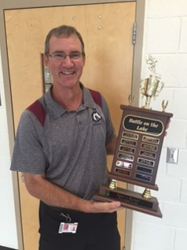
LEDE Station #8
Create
LEDE
Who: Athletic Director, Mr. Riehl
What: Rivalry football game vs. Bradley
When: Sept. 29
Where: Bailey football field
Why: to win Battle on the Lake trophy

Slide 17
What did U come up with???
Read the LEDE
Whole-Class Discussion…

Slide 18
Practice Makes… BETTER!!!
Homework
Examine each CUT
Identify the 5 W’s & the HOOK
“CRAFT” a LEDE that follows “the recipe”
1-2 sentences MAX
30-45 words MAX
answers the 5 W’s
includes a dramatic HOOK 2 grab reader
Type into GoFormative.com next to the corresponding CUT
Notes:
For example, the lead is about 20-30 words, contains 5 W’s, a hook, etc. The middle contains the action, details of the story, quotes, etc. The end contains a quote, a finite ending, etc.

Slide 19
Cut #1

Slide 20
Cut #2

Slide 21
Cut #3

Slide 22
Cut #4

Slide 23
Cut #5

Slide 24
Cut #6

Slide 25
Cut #7

Slide 26
Cut #8

Slide 27
Cut #9

Slide 28
Cut #10

