Slide 1
Lesson 4.1 How to
your reader

Slide 2
It doesn’t matter whether it’s hard or soft news…
It all begins with the perfect LEDE
5 W’s + HOOK = LEDE

Slide 3
LEDE Details…
Recipe for Crafting the Perfect LEDE
1-2 sentences MAX
Answers ALL of 5 W’s
You’ll usually save your Why and How for later in the article (if they’re known!), but they’re important, too!
Insert dramatic HOOK to grab the reader
Parts
HOOK-
coolest fact or most interesting detail you can find
5 W’s-
key facts (Who, what, where, when, why, how)

Slide 4
Types of …
LEDE Hooks
8 Different Styles
* B.B.B.H. * Punch
* Contrast * Question
* Picture * Direct
* Bkgd. * Quotation

Slide 5
1. B ig B ad B oring H ook
This is what you do now… and it is not a good option!!!
DON’T DO THIS ANYMORE!!!
What does it do?
Has all the elements for a LEDE
Usually feels long
Bland
Boring
Example-
This evening at about 9:30 p.m. at Ford's Theatre, the President, while sitting in his private box with Mrs. Lincoln, Mrs. Harris and Major Rathburn, was shot by an assassin, who suddenly entered the box and approached the President firing a single-shot Derringer pistol into the back of his skull.

Slide 6
2. CONTRAST Hook
What does it do?
draws contrast between two opposite extremes –
tragedy with comedy
past with present
age with youth
Example-
Less than 11 years ago, two college buddies decided to build a website to exchange their favorite videos with each other. Today, YouTube is owned by Google, receives 25 million unique visitors each month, and is worth nearly $40 billion.

Slide 7
3. PICTURE Hook
What does it do?
draws a vivid word picture of the person or in the story
idea is to have the reader see the thing as the writer saw it.
Example-
Standing straight and tall, smile glistening, brow unfurrowed, eyes sparkling with delight, Mary told of her dramatic attitude change, having seen her relationships turn around after speaking with a counselor.

Slide 8
4. BACKGROUND (BKGD.) Hook
What does it do?
Similar to picture lead
Except…
Paints vivid word picture of the news setting, surroundings, or circumstances
Example-
Crashing seas, hurricane winds and torrential rains thundered the ship as it set out on its dramatic mission of mercy in the North Atlantic.

Slide 9
5. PUNCH Hook
What does it do?
Consists of blunt, explosive statement
Designed to surprise, startle, or jolt the reader
Example-
President Lincoln shot dead at Ford’s Theatre!

Slide 10
6. QUESTION Hook
What does it do?
leads with a pertinent question
designed to arise reader’s curiosity
can’t be a “yes” or “no” (closed-ended) question
Example-
How does your bank’s interest rate compare to other big-name banks?

Slide 11
7. DIRECT ADDRESS Hook
What does it do?
speaks directly to the reader
makes them collaborators with facts in the story
usually employs the pronouns "you" and "your"
Example-
If you are one of the 30 million Americans working for a company with a private pension plan, Congress has given you a new Bill of Rights.

Slide 12
8. QUOTATION Hook
What does it do?
Features a short, eye-catching quote or remark
Used only if quote is so important or remarkable that it overshadows other facts of the story
Example-
"You really don't know what freedom is until you have had to escape from terrorist captivity," says Tom Dennon, an Air Force pilot stationed in Iraq.

Slide 13
Practice
The story: your peer’s arrival at school
talk with someone sitting near you, even if you don’t know him/her!
Must be written in 3rd person
no “I,” “me,” or anything like that
Example-
Who: (your peer’s first and last name—double-check its correct spelling!)
What: arrived at school
Where: Bailey Middle School in Cornelius, NC
When: (closest approximate time he/she actually arrived)
Why: to attend school
How: (how did he/she get here? Bus? Car? Carpool? Bicycle?)

Slide 14
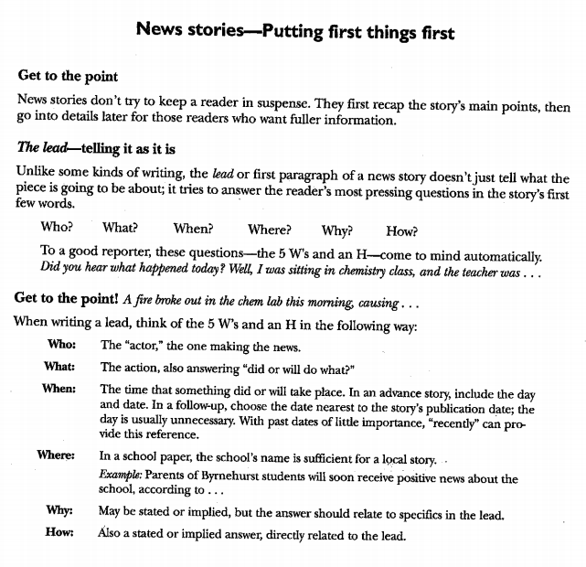

Slide 15
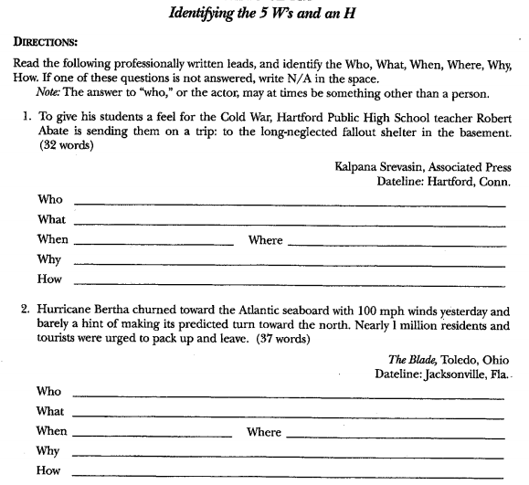

Slide 16
