Slide 1
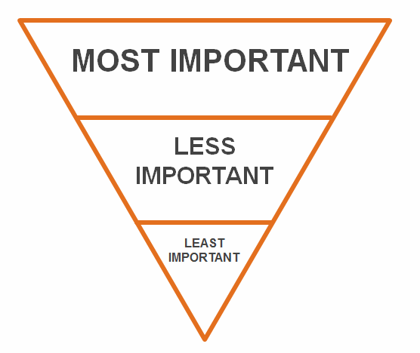
Unit 3: Is it Newsworthy?
3-3: The Inverted Pyramid, 5 W’s, and Writing a Lede

Slide 2
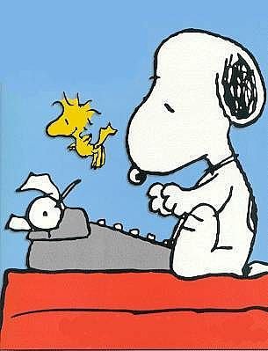
Time to Write!
A journalist works hard before they even write!
They’ve researched, interviewed, researched again, interviewed more, and researched that!
Common Sense would say to write the story chronologically
In order of events based on time
However…

Slide 3
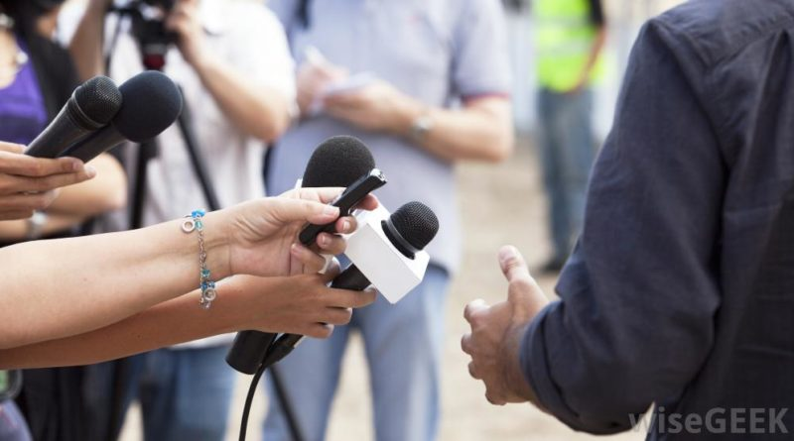
What’s the Story Actually About?
The most important part of the story is the result or outcome.
That’s where a journalist starts…
The story begins with the way the story ends…

Slide 4
The Inverted Pyramid: for HARD NEWS ONLY
THE LEDE - The first paragraph of the story--contains the most important info
MOST NEWSWORTHY INFORMATION
Who? What? When? Where? Why? How?
IMPORTANT DETAILS
Hard news stories are told in order of importance!
GENERAL
INFO & OTHER DETAILS

Slide 5
Nut Graph
A lede is the most important information in a news story and always comes first.
However, if you give details that are too specific, it can actually be difficult to understand.
The lede should be written in the form of a nut graph to help the reader better understand the main points of a story. (The more specific details will come in the next paragraph.)

Slide 6
Nut Graph
“Nut” means “in a nutshell”
“Graph” comes from “paragraph”
Example:
ROWAN COUNTY, NC (WBTV) -Firefighters responded to a two-alarm fire at a home in Rowan County Thursday night.
According to officials, the incident happened in the 1200 block of Bronco Run in West Rowan.
The fire happened at a single wide home, and the storage shed was damaged.
There were no injuries, and the fire had a quick control time.
There's no word on how the fire started.
This is a developing story and no further information has been released.
Source: http://www.wbtv.com/story/37684285/heavy-fire-reported-at-home-in-rowan-county

Slide 7
Nut graph
ROWAN COUNTY, NC (WBTV) -Firefighters responded to a two-alarm fire at a home in Rowan County Thursday night.
According to officials, the incident happened in the 1200 block of Bronco Run in West Rowan.
The fire happened at a single wide home, and the storage shed was damaged.

Slide 8
4 hurt in serious crash that shut down I-485 in Ballantyne
CHARLOTTE, N.C. — The outer loop of Interstate 485 in Ballantyne was shut down for a serious crash on Friday, according to the Charlotte Fire Department.
The crash happened at the Johnston Road exit around 4:30 p.m.
Chopper 9 Skyzoom flew over the scene where traffic was backed up for nine miles, and firefighters had surrounded two vehicles with serious damage.
It’s unclear what led to the crash.
MEDIC said four people were taken to the hospital: three with serious injuries and one with non-life-threatening injuries.
Officials said the interstate reopened around 5 p.m.
https://www.wsoctv.com/news/local/serious-crash-shuts-down-i-485-ballantyne/4OJ6EUU32VEEBPEDKEEWGWKDOA/

Slide 9
LEDE:
Identify the 5 W’s:
What?
Who?
Where?
When?
Why?
How?
The outer loop of Interstate 485 in Ballantyne was shut down for a serious crash on Friday, according to the Charlotte Fire Department.

Slide 10
LEDE:
Identify the 5 W’s:
What?
Who?
Where?
When?
Why?
How?
Who’s the source?
The outer loop of Interstate 485 in Ballantyne was shut down for a serious crash on Friday, according to the Charlotte Fire Department.

Slide 11
Lede AND Nut Graph:
CHARLOTTE, N.C. — The outer loop of Interstate 485 in Ballantyne was shut down for a serious crash on Friday, according to the Charlotte Fire Department.
The crash happened at the Johnston Road exit around 4:30 p.m.

Slide 12
APPLY… THE INVERTED PYRAMID
Let’s suppose the City Police Department reports that an accident occurred at 2:30 a.m. today.
This is the information the police provided to YOU, the press:
A car driven by Joe White, 29 years-old,
Hit a curb on Main Street in Charlotte, NC & smashed into a tree and overturned.
Police say White was speeding and lost control of his car.
He was hospitalized for minor injuries.
A passenger in White’s car was killed.
The passenger was Amanda Smith, 22 years-old.
She was pronounced dead at 2:45 a.m.
“We are conducting toxicology tests to determine if alcohol was involved,” Police Chief Jack Russell said.

Slide 13
Identify the 5 Ws, then organize the information by importance
Most important outcome: A woman died
This Fact is even more important than the accident itself
5 W’s
Who: Man & passenger (Driver Joe White and passenger Amanda Smith)
What: Fatal car accident
When: 2:30 a.m. today
Where: Charlotte, NC--off Main Street
Why: The driver, Joe White was speeding and lost control
How: The car hit a curb, smashed into a tree and overturned
Source
Where did the information come from?
All of the information must be tied directly to the source where it came from: THE POLICE.
This is called attribution

Slide 14
Prioritize your 5 W’s—find the “What”
The “main idea” of the story. What the story is truly about.
Identify this FIRST.
The “Why” answers the “What.”
The “How” answers the “What.”
Sometimes one or both are missing.
What
Who
Where
When
Why
How

Slide 15
The Inverted Pyramid
MOST NEWSWORTHY INFORMATION
Who? What? When? Where? Why? How?
Put it all together to make a LEDE
A 22 year-old woman was killed in an automotive accident early this morning in North Charlotte.
IMPORTANT DETAILS
GENERAL
INFO & OTHER DETAILS

Slide 16
The Inverted Pyramid
MOST NEWSWORTHY INFORMATION
Who? What? When? Where? Why? How?
2nd Step-
Insert Other Important Details
According to CMPD, 29 year-old Joe White exceeded the speed limit and lost control of his vehicle on Main Street around 2:30am, causing the death of Amanda Smith.
IMPORTANT DETAILS
GENERAL
INFO & OTHER DETAILS

Slide 17
The Inverted Pyramid
MOST NEWSWORTHY INFORMATION
Who? What? When? Where? Why? How?
3rd Step-
Insert General Information & Other Details
White was hospitalized for minor injuries. “We are conducting toxicology tests to determine if alcohol was involved,” Police Chief Jack Russell said. No additional information has been released at this time.
IMPORTANT DETAILS
GENERAL
INFO & OTHER DETAILS

Slide 18
You just wrote a news story
A 22 year-old woman was killed in an automotive accident early this morning in North Charlotte.
According to CMPD, 29 year-old Joe White exceeded the speed limit and lost control of his vehicle on Main Street around 2:30am, causing the death of Amanda Smith.
White was hospitalized for minor injuries. “We are conducting toxicology tests to determine if alcohol was involved,” Police Chief Jack Russell said. No additional information has been released at this time.

Slide 19
Your Turn
MOST NEWSWORTHY INFORMATION
Who? What? When? Where? Why? How?
IMPORTANT DETAILS
Apply the Inverted Pyramid to
the following:
The police have shared these
facts with you, a journalist:
Around 4:35am this morning, a robbery was reported at a bank off East 4th Ave near I-277 in Charlotte, NC (Bank USA)
Over $5,000,000 in cash was stolen, along with at least $3,000,000 in valuables from security deposit boxes were also stolen, including jewelry and bonds.
Police are reviewing video footage to attempt to identify the suspect, who appears to be male, approximately 5’ 10”, and 170 pounds.
GENERAL
INFO & OTHER DETAILS

Slide 20
BREAKING NEWS
-Rock Hill police just ended a high-speed chase on I-77 South.
-They were in pursuit of a suspect of a bank robbery earlier this morning in Charlotte.
-The pursuit ended at approximately 7:10am with the help of citizens who helped police blockade the suspect’s moving vehicle and eventually came to a complete stop along the highway, forcing the highway to temporarily close.
-The suspect, Kenneth Moore, 46, was taken into custody in Rock Hill, SC around 7:15am by Rock Hill police
-Moore has since been handed over to Charlotte Mecklenburg Police Department

Slide 21
Quotes aren’t always short…
-A spokesperson for CMPD, Lieutenant Lisa Fitzgibbons, stated the following (which you were able to record, along with the other press present):
“Thanks to the joint efforts of Rock Hill police and the brave citizens who were simply on their way to work this morning, the pursuit ended and the suspect was taken into custody. We are thankful that no one was hurt, especially the citizens who assisted police in slowing the suspect’s vehicle. Anything could’ve happened along that highway, and even though the suspect was not armed, he could’ve been, and that could’ve resulted in a very different story this morning. Like I said, thankfully no one was hurt, and that’s all the questions we’re able to take at this time. Thank you.”
On your paper, underline the most important and usable portions of the above quote.

Slide 22
Write your own story! On a separate sheet— you’re turning this in!
MOST NEWSWORTHY INFORMATION
Who? What? When? Where? Why? How?
IMPORTANT DETAILS
The story: the most interesting
thing that happened to you
this past weekend (i.e. the school
dance)
After choosing this, write out the details—including more than just the 5 Ws.
Identify your 5 Ws (you can color-code them if it helps you), choose your hook, and write the rest of your story!
The story won’t be long! News stories are short!
GENERAL
INFO & OTHER DETAILS

