Slide 1
Unit 3: Is it Newsworthy?
3-2 Types, Parts, & Pieces

Slide 2
Unit 3: Is it Newsworthy?
Hard News vs. Soft News

Slide 3
2 Types of News
Hard News
Soft News
quickly provides the reader with as much information as possible
Purpose- is to inform the reader
a facts-based story
Accidents
Crimes
Court Cases
Natural Disasters
(earthquakes, floods)
New government legislation
News from city hall
usually appears in the entertainment or lifestyle sections of a newspaper
often profiles an individual who is newsworthy because he or she has “accomplished” something
Example- it’s common to read stories on singers or bands who release a new CD.
The news part of the story is the release of the CD.
Soft stories can also inform the reader by offering advice on health, fitness, fashion, home décor, or food preparation.

Slide 4
Unit 3: Is it Newsworthy?
Parts of an Article

Slide 5
Headline
Deck
By-Line
Cut / Photo
Cut line / Caption
Cut / Photo
Quote
By-Line
Columns

Slide 6
Unit 3: Is it Newsworthy?
Parts of a Newspaper

Slide 8
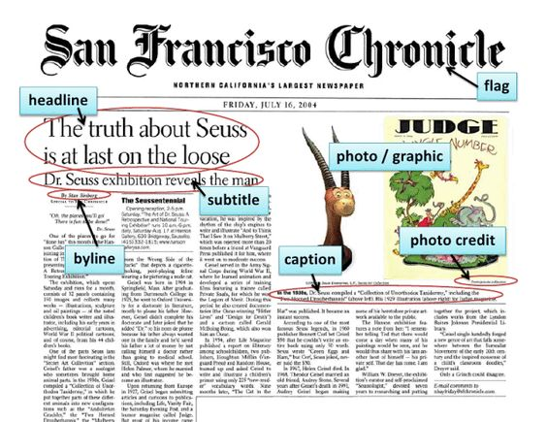
mast head
deck

Slide 9
Sections Within a Newspaper

Slide 10
Sections and Types of Articles within a Newspaper
News Section
These are the most important stories and appear on the front page. These stories are the “hardest” news to report to the public.
Sports Section
The sports section contains all types of articles about sports--news, features, and opinion/editorial articles. Anything to do with sports is in this section and includes hard and soft sports news.
Feature Section
A feature article is soft news and often takes more time to write because it’s not as important to inform the public about. Feature articles are windows into the human experience, giving more detail and description than a hard news story, which typically relies on the style of writing. Features focus on an event or individual, giving the reader a chance to more fully understand some interesting dimension of that subject.
Opinion/Editorial (Op/Ed) Section
This section gives a newspaper staff or its readers a chance to write their opinion about a topic--no other type of article may include the writer’s opinion.

