Slide 1
Unit 3: Is it Newsworthy?
3.1: Newsworthiness, Target Audience, & Layout

Slide 2
Information vs. News
Define-
Information
News
Think / Pair / Share
Is there a difference between information & news?
Brainstorm
What about them makes them different?

Slide 3
Information vs News
Information:
1. knowledge gained
through study,
communication,
research,
instruction, etc.
2. factual data
News:
1. the presentation
of a report on recent or
new events in a
newspaper or
other periodical or on
radio or television.
I
N

Slide 4
Decisions, Decisions...
MANY things happen in our world every day
How do news organizations decide which stories to report and which ones to leave out?

Slide 5
Newsworthiness
“…newsworthiness is ‘worthy of being published as news,’ and the criteria that are commonly used to determine newsworthiness are known as news values.”
-Oxford Research Encyclopedia of Communication

Slide 6
The 5 Values of… Newsworthiness

Slide 7
Timeliness
Immediate, current information and events are newsworthy because they have just recently occurred. It’s news because it’s “new.”

Slide 8
Proximity
Local information and events are newsworthy because they affect the people in our community and region. We care more about things that happen “close to home.”

Slide 9
Conflict & Controversy
When violence strikes or when people argue about actions, events, ideas or policies, we care. Conflict and controversy attract our attention by highlighting problems or differences within the community.

Slide 10
Human Interest
People are interested in other people. Everyone has something to celebrate and something to complain about. We like unusual stories of people who accomplish amazing feats or handle a life crisis because we can identify with them.

Slide 11
Relevance
People are attracted to information that helps them make good decisions. If you like to cook, you find recipes relevant. If you’re looking for a job, the business news is relevant. We need depend on relevant information that helps us make decisions.

Slide 12
Target Audience

Slide 13
The Ultimate Factor of Newsworthiness
Audience Decides!
What’s newsworthy depends on the target audience
Writers write to particular (target) audiences
A target audience is the particular group of people to which an advertisement, a product, a website or a television or radio program is directed
Examples-
15 year old to Senior Citizen
Urban vs. Rural
Who is our target?
What if kids were the target?
Time for Kids
CNN Student News
Made by adults for kids
Do they do a good job?

Slide 14
Target Audience
A few
determining
factors:
Age
Income
Education
Gender
Where you live
Religion

Slide 15
Layout
Why do they put which stories where?

Slide 16
Where to find the most newsworthy stories
Where should I look to find the most newsworthy stories?
Above the Fold
position where it is seen first, for example on the top half of the front page of a newspaper or in the part of a web page that you see first when you open it
Centerpiece Story
an item or issue intended to be a focus of attention. In online journalism it is the story that viewers see first on the webpage
Sections
Front Page (News)
Style (Features)
Sports (News and Features)
Classifieds (Ads, personal ads)
Arts and Leisure (Features)

Slide 17
Headlines
Headlines are everything!
Headline = Article Title
First thing a reader reads
Helps them decide whether to read your article
It’s like bait, but do all headlines truly reflect the content of the article? Sometimes yes—sometimes no!
Why would a headline be misleading on purpose?

Slide 18
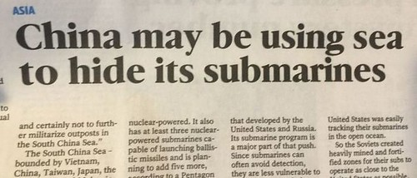
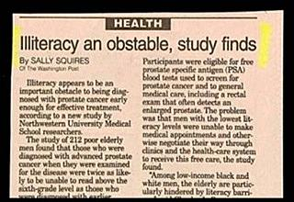
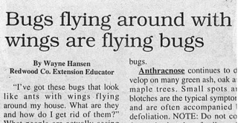
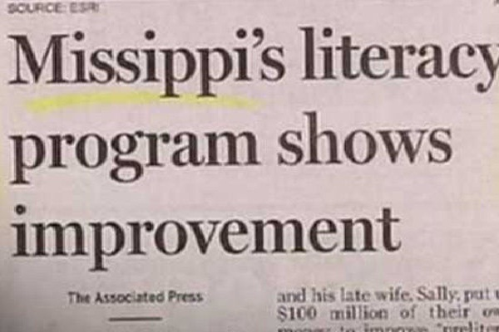
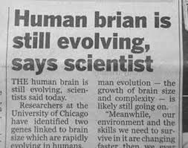

Slide 19
